Slide 1

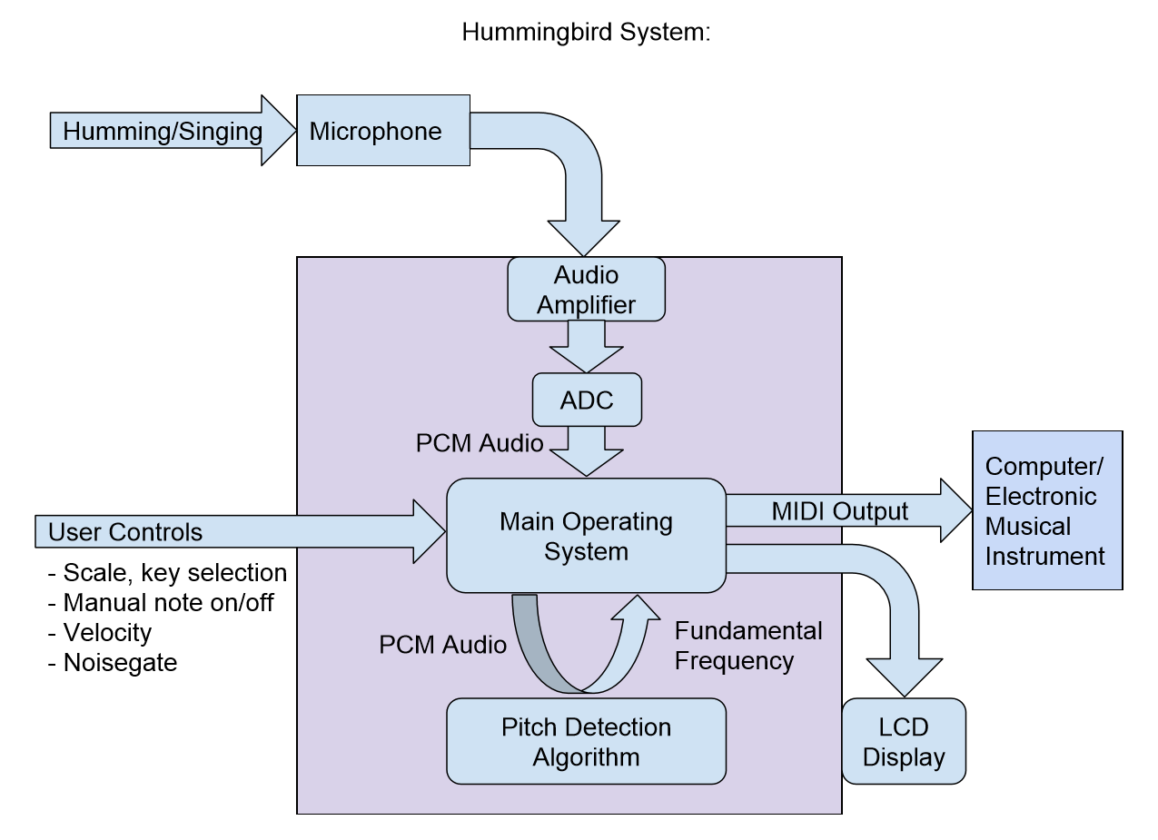
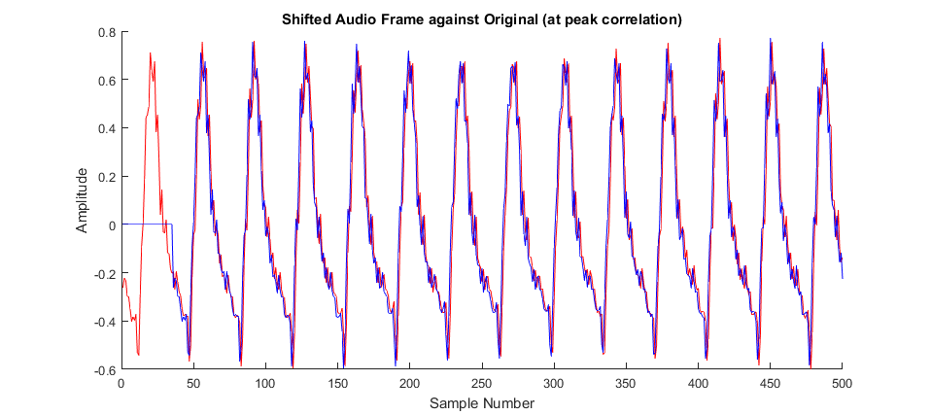
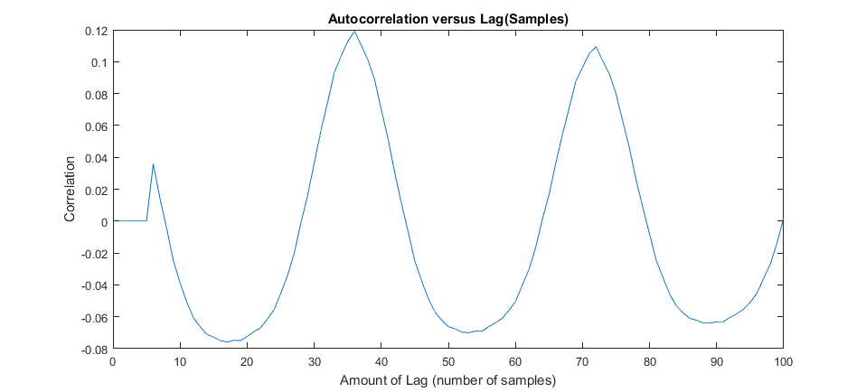
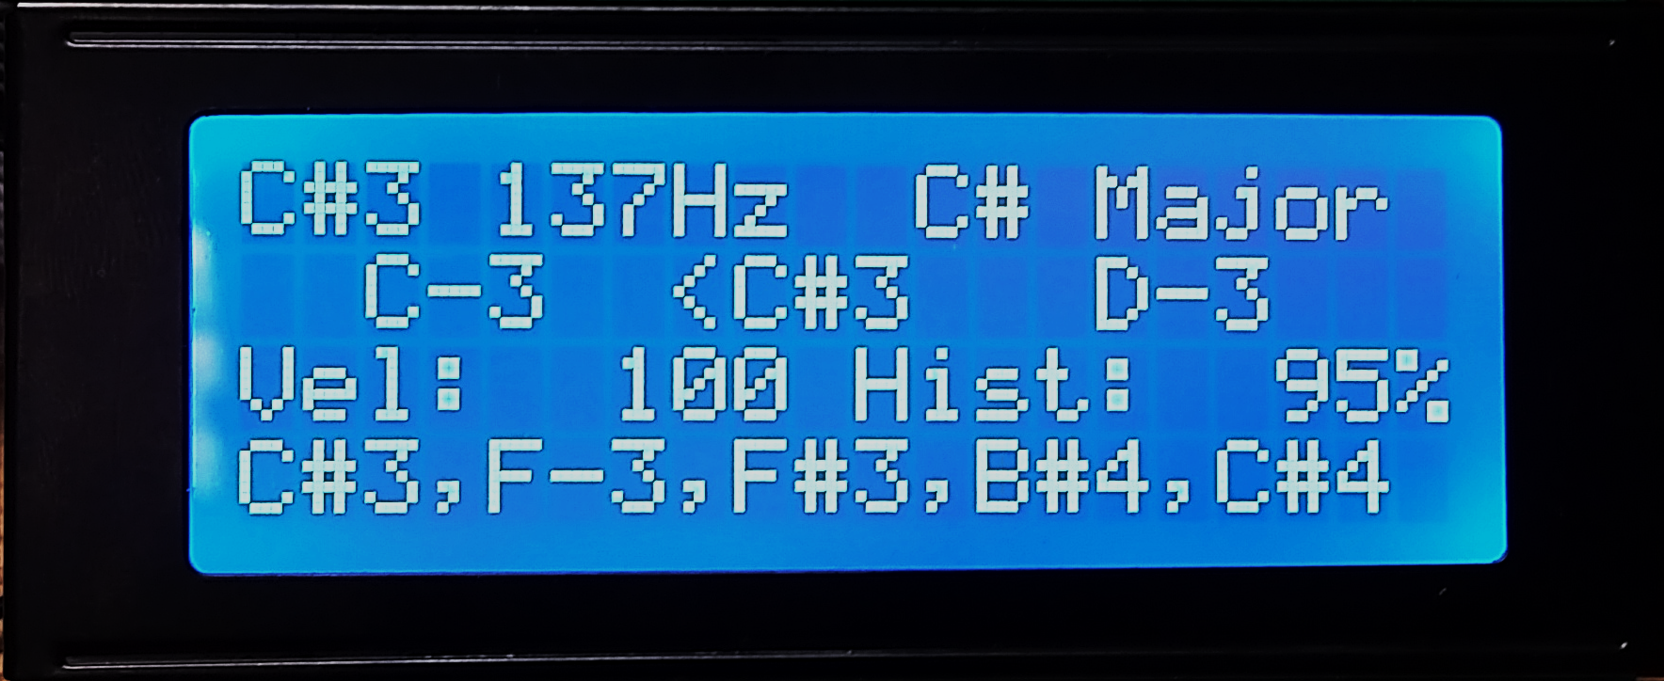
Hummingbird: Acoustic Control for Electronic Musical Instruments
Joey Devoto, Marcus Gronberg, Andre Marquez, Jason Vance
Abstract
Overview
Analysis
There are numerous tools that allow musicians to create electronic music. However, the primary method of composition is either some type of digital piano or mouse-and-keyboard composition in a Digital Audio Workstation. Our goal is to deliver a system that makes the process of creating digital music more intuitive and easy.
The Hummingbird is a music tool that allows the user to play musical instruments and compose music by humming. The pitch hummed by the user is converted into MIDI data, which can be used to play instruments or record compositions using a Digital Audio Workstation. This process happens in real-time, giving the user the sensation and control associated with playing a traditional instrument, while retaining the low skill required to simply hum melodies as they come to mind.
Pitch Detection Algorithm (Autocorrelation):
The PDA functions by comparing the original audio frame to time lagged versions of itself.
By sweeping across a set of time lagged copies of each frame, the fundamental frequency of each frame can be determined
Approach
Platform
Developed on a CY8CKIT-059 PSoC 5LP Prototyping Kit
Audio Acquisition:
-Microphone Amplification:
The signal from the mic is fed into an analog amplification circuit before it is captured by the ADC.
-Analog to Digital Conversion:
Preformed using the onboard successive approximation ADC.
Pitch Detection Algorithm:
The input audio is sampled at a rate of 4000 samples/second into frames of 256 samples
Each frame is processed by the pitch detection algorithm to detect the fundamental frequency
This frequency is converted into a MIDI note, and is output over USB or MIDI port.
Conclusion
Our team’s ambition is to break down the barrier between creative thought and execution. Using this system, musicians of mixed skill levels can collaborate and explore artistic ideas beyond the inhibitions of their technical dexterity. The application of this system is not limited to music production, and might be applied towards musical education as well. We hope to move the project into commercial development in the near future.
Note, Frequency, Key/Scale
Tuner
MIDI Velocity, Hysteresis
Previous Notes
Acknowledgments
Project Mentor – Dr. Patrick E. Mantey
Peer Advisor – Eric Cao

